Slide 1

BRACT’S, Vishwakarma Institute of Technology, Pune-48
Department of Computer Engineering
Academic Year: 2025-26
Blogsphere
Presented By :
Roll No. | PRN No. | Name
28 | 1252070028 | Ananya Morti
34 | 1252070034 | Pralhad Chape
45 | 1252070045 | Nandini Kurle
46 | 1252070046 | Vedika Kore
Guided By :
Mrs.Disha Wankhade

Slide 2

What is Blogsphere?
Blogsphere is a dynamic and intuitive blog management system, meticulously engineered on the robust MERN stack. It offers content creators a seamless platform to create, edit, delete, and organize their blog posts with unparalleled ease and efficiency.
This innovative platform unifies modern web technologies, providing a comprehensive full-stack JavaScript development experience that prioritizes both performance and user-friendliness.

Slide 3
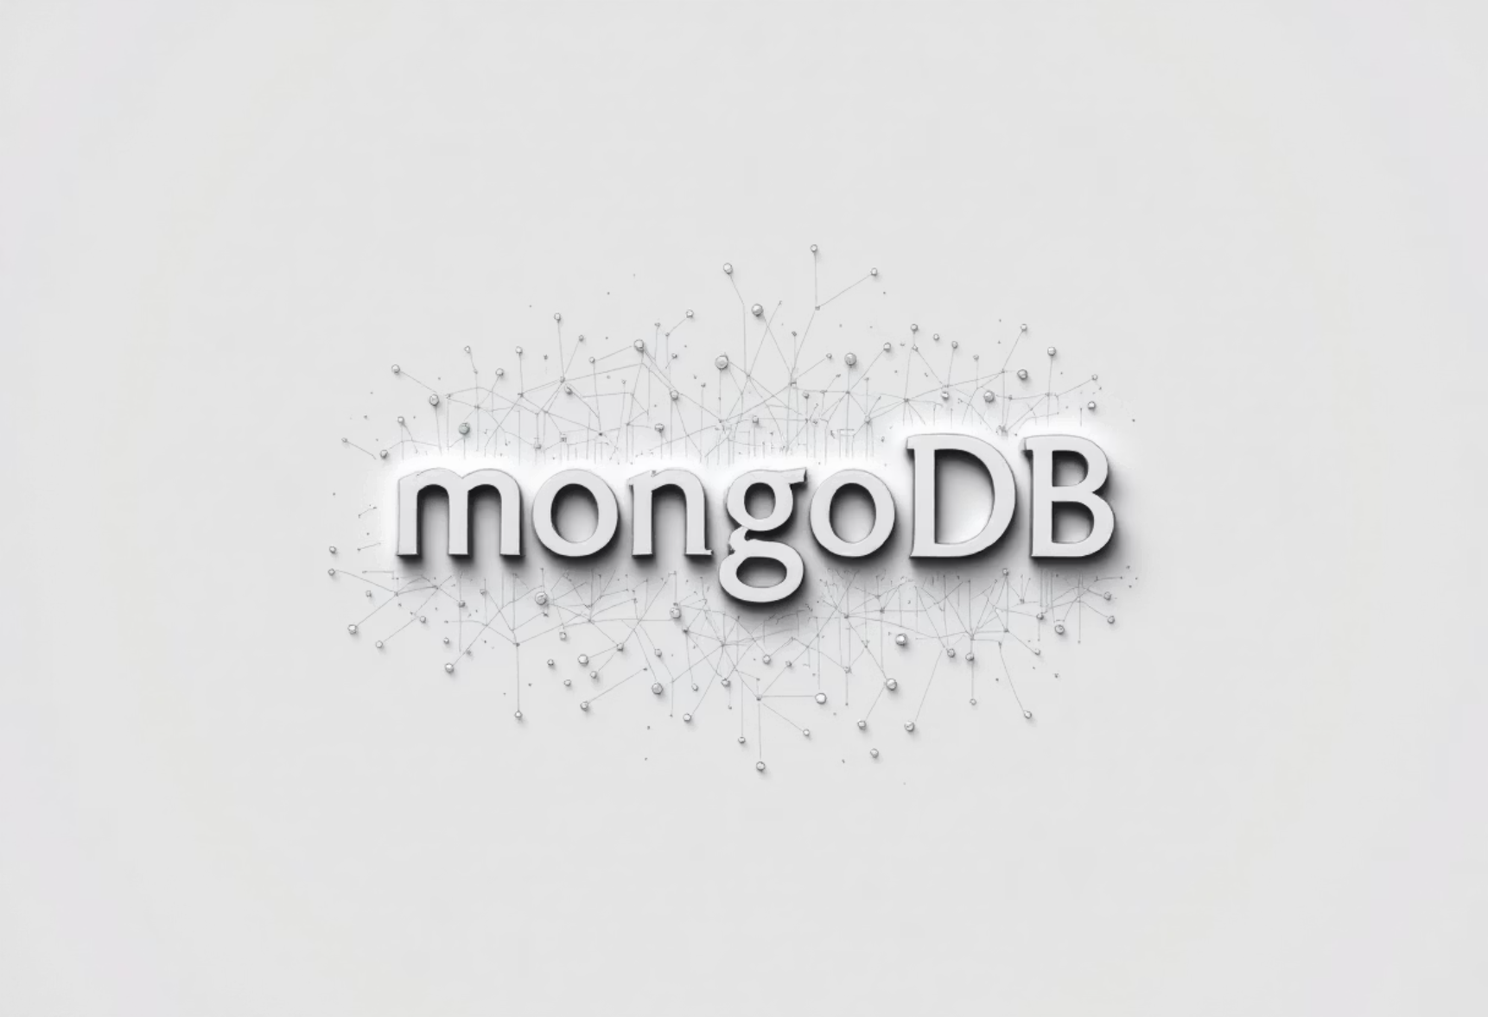
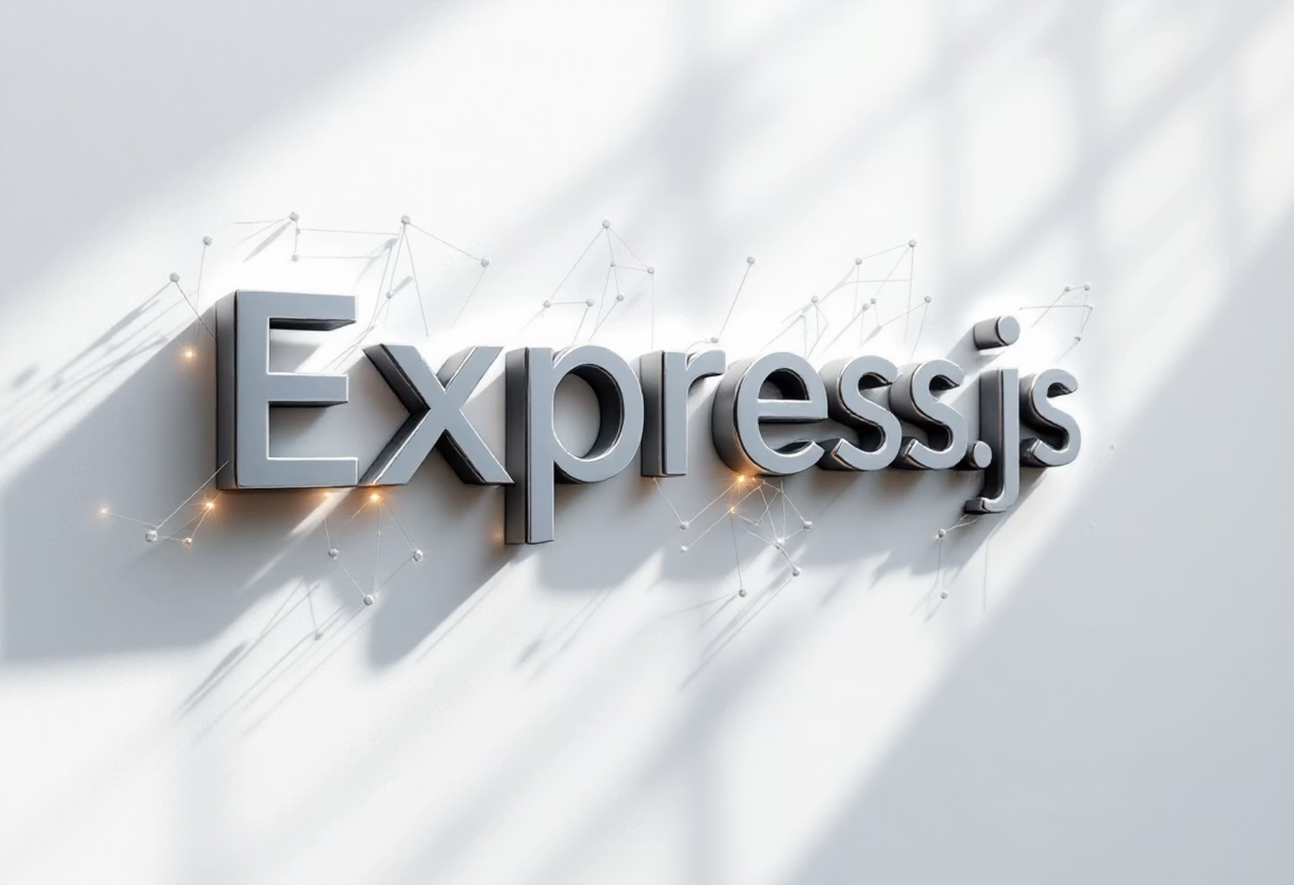
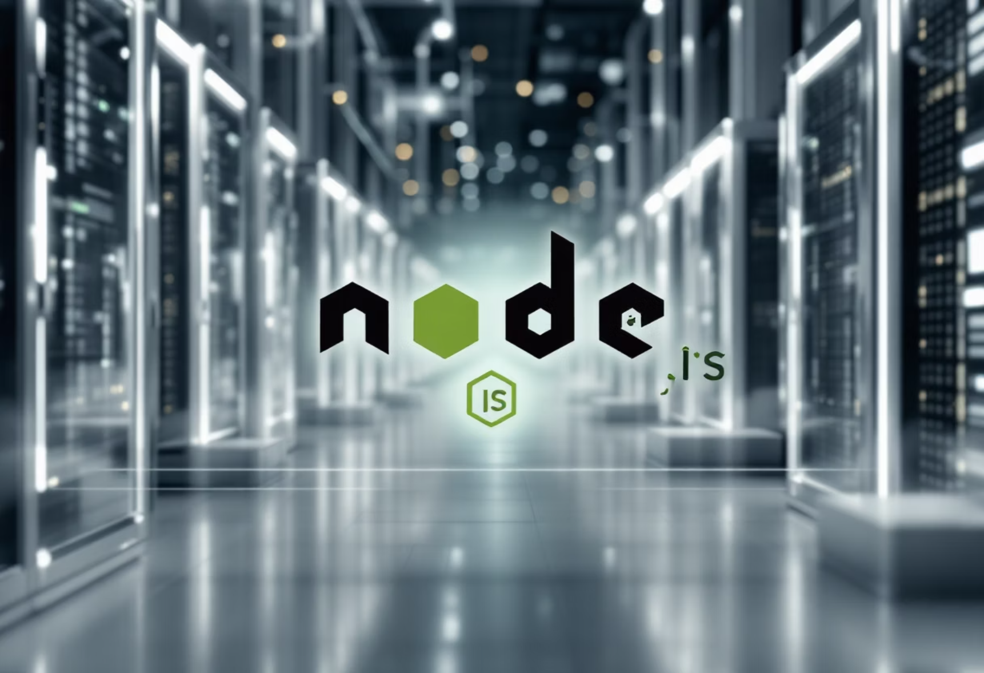

The MERN Stack Explained
MongoDB
Express.js
NoSQL Database: Stores blog data as flexible, schema-less JSON documents, allowing for agile evolution of content structures.
Backend Framework: Facilitates robust API routes and handles complex business logic, ensuring efficient server-side operations.
React.js
Node.js
Frontend Library: Builds highly interactive and responsive user interfaces, delivering a smooth and engaging user experience.
JavaScript Runtime: Powers the server environment, enabling full-stack JavaScript development and high-performance applications.

Slide 4
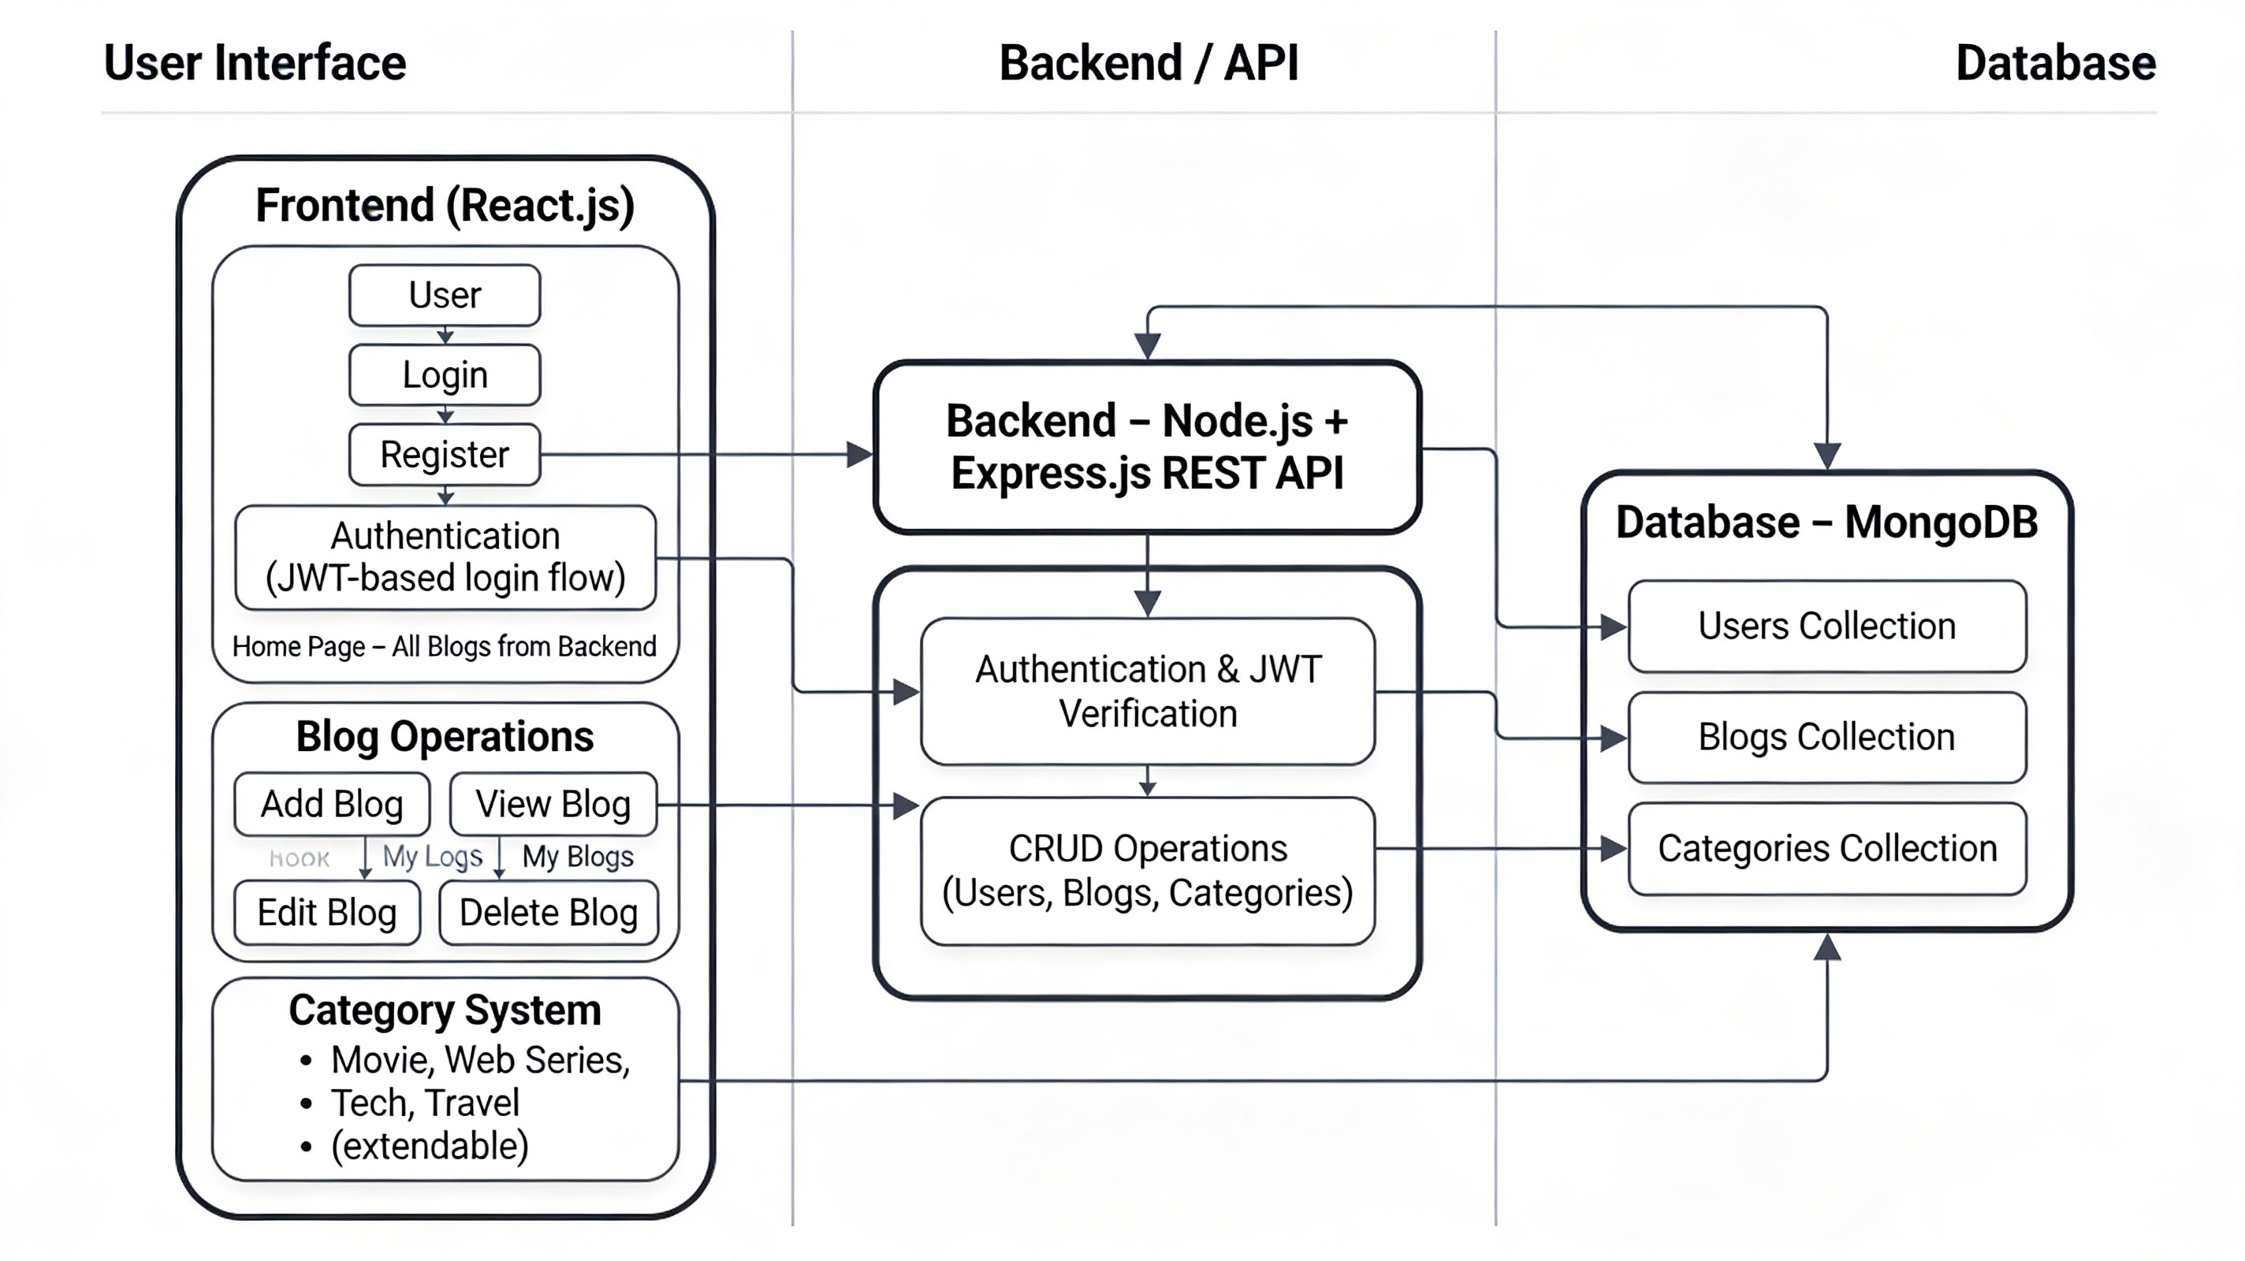
Block Diagram
RESTful API designed with Express.js and Node.js for high performance.
Comprehensive CRUD operations cover blog posts and user profiles.
Secure user authentication implemented with JSON Web Tokens (JWT) and strong password hashing.
MongoDB integration managed through Mongoose ODM for streamlined schema validation and data interaction.

Slide 5




API Development Workflow
Initialize Project
Define Data Models
Set up the Node.js environment, integrating Express and Mongoose for rapid development.
Create BlogPost and User schemas with Mongoose, incorporating timestamps for data integrity.
Implement Routes
Add Middleware
Develop API endpoints like /posts and /users for GET, POST, PUT, and DELETE operations.
Integrate middleware for secure authentication, authorization, and comprehensive error handling.

Slide 6
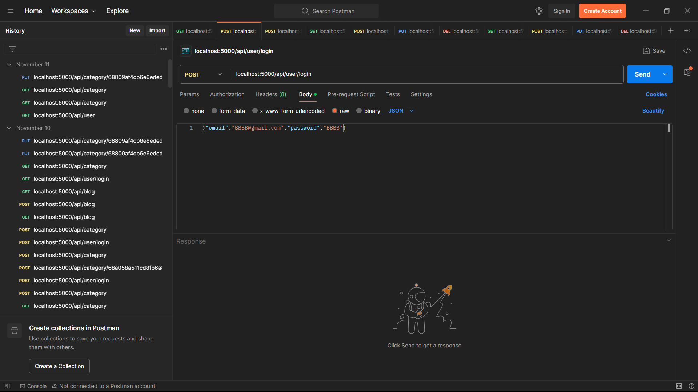
Testing APIs with Postman
Postman serves as a critical tool in the Blogsphere development workflow, allowing for rigorous and independent verification of all API endpoints. This meticulous testing phase is crucial for ensuring the backend's reliability and stability before frontend integration begins.
Comprehensive Test Cases: Validating creation, retrieval, updates, and deletion of blog posts.
User Authentication Flows: Thoroughly testing user registration, login, and token management.
Authorization Protection: Ensuring that protected routes correctly restrict access based on user roles and permissions.

Slide 7

Frontend Integration with React
The frontend of Blogsphere is masterfully crafted using React, creating a dynamic and engaging user interface.
API Consumption: React components efficiently fetch and send data to the backend APIs using Axios, ensuring real-time data synchronization.
State Management: Advanced state management techniques are employed to facilitate dynamic UI updates, reflecting changes in blog data instantaneously.
Responsive Design: The interface is designed to be fully responsive, providing a seamless and optimized user experience across all devices, from desktops to mobile phones.

Slide 8








Benefits of Using MERN for Blogsphere
Unified Language
Flexible Schema
JavaScript across the entire stack simplifies development and fosters a cohesive team environment.
MongoDB's adaptable schema easily accommodates evolving blog features without complex migrations.
Fast API Responses
Scalable & Maintainable
Node.js's event-driven architecture ensures quick and efficient backend performance.
Modular components lead to a codebase that is both scalable for growth and easy to maintain.

Slide 9

Real-World Impact & Future
Enhancements
Blogsphere empowers content creators with cutting-edge tools to manage their digital presence effectively. It's more than just a platform; it's a foundation for creative expression and efficient content delivery.
Future Possibilities:
Enhanced Functionality: Integration of advanced search capabilities, comment sections, and microservices for richer user interaction.
Cloud Deployment: Streamlined deployment to various cloud platforms with robust CI/CD pipelines, ensuring continuous updates and scalability.

Slide 10

Conclusion: Blogsphere Empowers Modern Blogging
1
2
Robust Solution
Quality Assurance
The MERN stack delivers a powerful, scalable, and secure blog DBMS solution, perfectly tailored for the demands of modern blogging.
Rigorous Postman testing ensures exceptional API quality, translating into a smooth, reliable, and delightful user experience.
3
4
Full-Stack Excellence
Future-Ready
Blogsphere stands as a prime example of a full-stack JavaScript application, showcasing excellence in design, development, and functionality.
Designed for agility, Blogsphere is ready to evolve, adapt, and integrate new features, meeting future user demands and technological advancements.

